Slide 1

Feature-Based Recommendation System

Slide 2

Introduction
The feature-based recommendation algorithm is like a matchmaker for online shopping or streaming services. It looks at the special traits of products and what you like, then suggests things you might enjoy. It's like having a friend who knows exactly what movies or products you'll love, based on what you've liked before and the unique features of each item. This algorithm makes shopping and finding entertainment easier and more personalized, making your online experience more enjoyable.

Slide 3

Why this algorithm needed ?
Discussing the challenges of providing recommendation in the domains where no sufficient historical data exist for measuring similarity between products or users. For that feature-based recommendation algorithms is used to overcome the limitations of the existing top-n recommendation algorithms.

Slide 4

Steps for Algorithm
Data Representation :-
Write down the dataset, representing each user and item (genre) along with their respective features.
Features could include preference scores for each genre, represented as numerical values.
2.Feature Engineering :-
Identify and list down the relevant features for each user and item.
Create feature vectors for each user and item based on their features.
3.Similarity Calculation:
Compute the cosine similarity between feature vectors.
For each pair of feature vectors (users or items), calculate the cosine of the angle between them using the formula:
where A and B are the feature vectors and ∥A∥ and ∥B∥ are their respective magnitudes.

Slide 5
Steps for Algorithm
4.Recommendation Generation :-
For a given user, identify users with similar preferences based on their similarity scores.
Aggregate the preferences of similar users to generate recommendations for the target user.
Genres that are highly preferred by similar users but not yet consumed by the target user are recommended.
5.Output Explanation :-
The output will be a list of recommended genres for the target user.
These recommendations are based on the preferences of similar users who have similar tastes to the target user.
The more similar a user is to the target user, the higher the influence of their preferences on the recommendations.
6.Interpretation :-
If a user is known to like certain genres (e.g., Action and Thriller), the algorithm may recommend other genres that users with similar tastes have also enjoyed (e.g., Mystery or Sci-Fi).
The recommendations aim to provide personalized suggestions based on the user's preferences and the preferences of similar users.

Slide 6
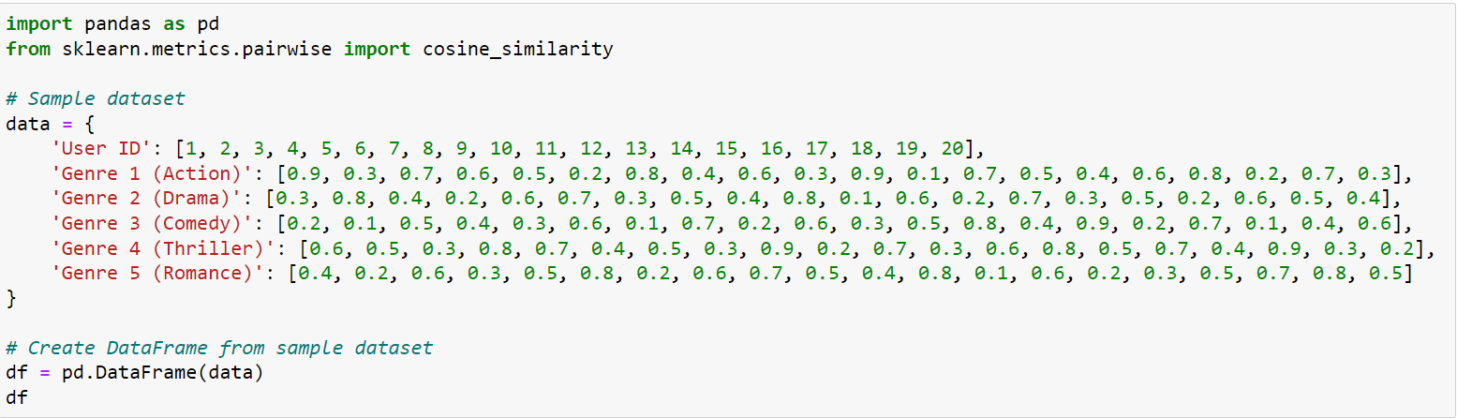
Implementation of dataset In Python

Slide 7
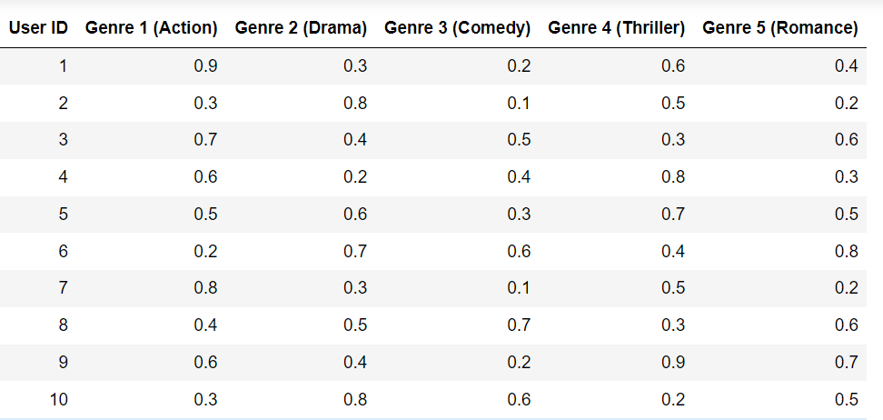
Output

Slide 8
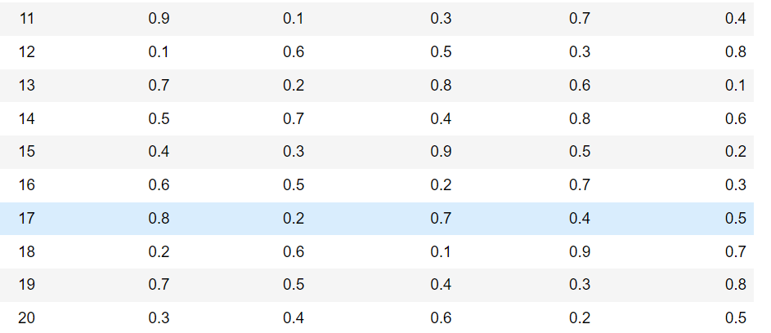
Output

Slide 9
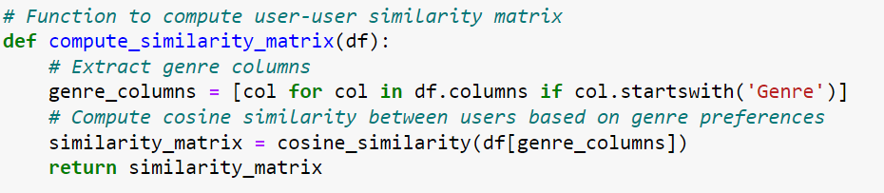
Actual Code

Slide 10
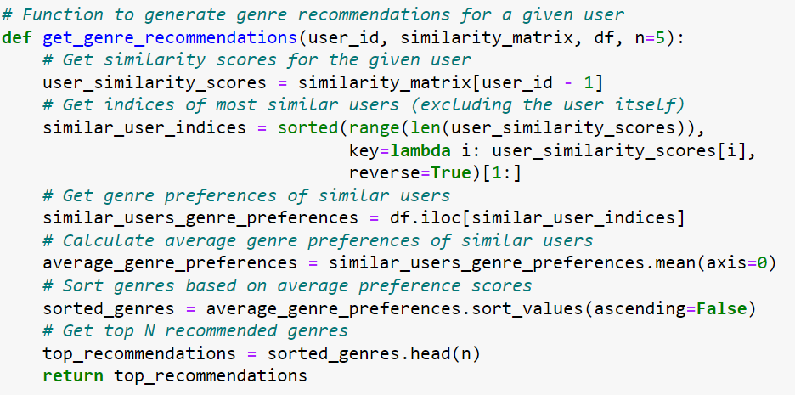
Actual Code

Slide 11
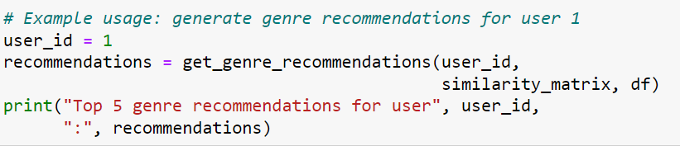
Actual Code

Slide 12
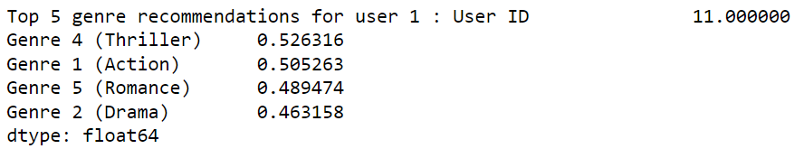
Output

Slide 13

Advantages :-
Personalization: Feature-based algorithms offer personalized recommendations based on user preferences and item characteristics. By considering features such as genre, category, or attributes, the recommendations are tailored to individual users' tastes.
Interpretability: Feature-based algorithms provide transparent recommendations because they rely on explicit features of items and users. Users can understand why certain recommendations are made based on the features they have interacted with in the past.
Flexibility: Feature-based algorithms are flexible and can incorporate various types of features, including textual, categorical, or numerical attributes. This allows for diverse recommendation scenarios across dif

Slide 14

Disadvantages:-
Feature Engineering Complexity: One of the main challenges of feature-based algorithms is feature engineering. Identifying relevant features and engineering effective representations requires domain knowledge and can be time-consuming.
Dependency on Feature Quality: The quality of recommendations heavily depends on the quality and relevance of the features used. Noisy or irrelevant features can lead to suboptimal recommendations or even exacerbate recommendation biases.

Slide 15

Conclusion
In conclusion, feature-based recommendation algorithms provide personalized and interpretable recommendations by leveraging explicit features of users and items. They offer scalability, flexibility, and can mitigate the cold-start problem to some extent. However, they require careful feature engineering and may face challenges with sparse data and cold-start scenarios. Despite these limitations, feature-based algorithms remain a valuable approach for generating tailored recommendations in various domains.

Slide 16

Thank you...
Submitted By :
Bhavesh Rajput(A270)
Hemant Jamadar(A269)
Chandrakant Mali (A270)

Slide 17
References
Association Of Computing Machinery
Authors: Eui-Hong (Sam) Han ,George Karypis
Published : 31 October 2005
https://dl.acm.org/doi/10.1145/1099554.1099683

